Slide 1
📊 Adidas Sales Analysis Dashboard – Project Summary
🏆 Objective:
The purpose of this Power BI dashboard is to deliver an interactive, insightful, and visually engaging analysis of Adidas sales performance across multiple dimensions (time, geography, product, and retailer). It is designed for business stakeholders to quickly monitor KPIs, identify trends, and make data-driven decisions.

Slide 2
📈 Key KPIs Displayed:
Total Sales: $900 Million
Sum of Units Sold: 2 Million
Price per Unit: $45
Operating Profit: $332 Million
Operating Margin: 42%
These KPIs are showcased at the top of the dashboard using KPI cards for immediate, at-a-glance insights.

Slide 3
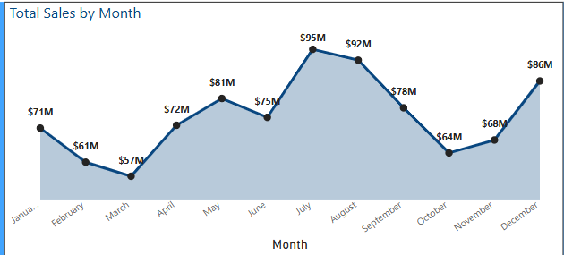
🗓️ Time Series Analysis:
A line chart tracks Total Sales by Month, highlighting monthly sales fluctuations over a two-year period (2020–2021).
Sales peaked in July ($95M) and August ($92M), while lower sales occurred in March and October.
Seasonal trends are clearly visible, enabling business teams to optimize promotions and supply chain planning.

Slide 4
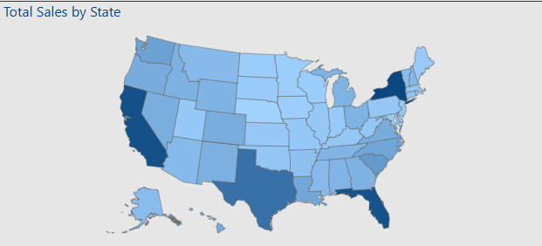
🗺️ Geographic Analysis:
A US map visualizes Total Sales by State, with darker shades indicating higher sales.
Key high-performing states are highlighted, offering quick geographical insights for regional strategy.

Slide 5
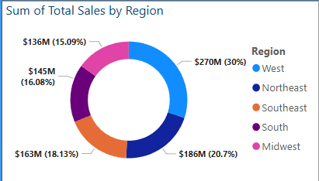
📊 Breakdown Analysis:
Sales by Region:
Represented via a donut chart.
West Region dominates with $270M (30%) of total sales.
Other major regions include Northeast (16.08%) and Midwest (20.7%).

Slide 6
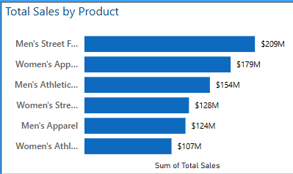
Sales by Product Category:
A horizontal bar chart displays top-selling product categories.
Men’s Street Footwear and Women’s Apparel lead the sales, generating significant revenue.

Slide 7
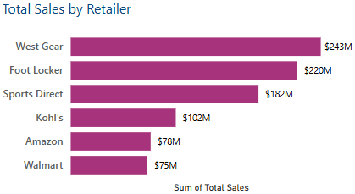
Sales by Retailer:
Another bar chart identifies West Gear and Foot Locker as the top-performing retail partners, driving $243M and $220M respectively.

Slide 8
🎯 Interactivity Features: Slicers allow dynamic filtering by Region and Invoice Date. Users can drill down into specific time frames and regions without leaving the dashboard. Tooltips provide additional insights when hovering over visuals. 🎨 Design Highlights: Consistent Adidas blue and white theme reflecting the brand identity. Clear visual hierarchy: KPIs at the top, trend analysis in the middle, and detailed breakdowns at the bottom. Data-driven storytelling using color coding, layout balance, and intuitive navigation.
🛠️ Tools Used:
Micro
soft Power BI
DAX for custom measures Power BI Slicers and filters
Map Visual, Donut Chart, Line Chart, Bar Charts

